Slide 1

Team 3
DEGREE PLANER
December 5th, 2016
System designed by:
RAMON BAUTISTA JR, MIGUEL SANCHEZ, OMOGBOLABO KUPOLUYI, KEVIN ENARIO, BABAK ARIAN, LOUIS WAGNER

Slide 2
Introduction
Scope of Software
Software context
Architectural and component-level design
Demo & Test Plan
Major Constraints

Slide 3
Degree Planner is a Software System that will resolve issues that prevent students from graduating in a timely manner at California State Universities.
Provide students with the proper resources to give them a better chance to graduate within the four year expected time
Help students choose their classes from semester to semester depending on their major

Slide 4
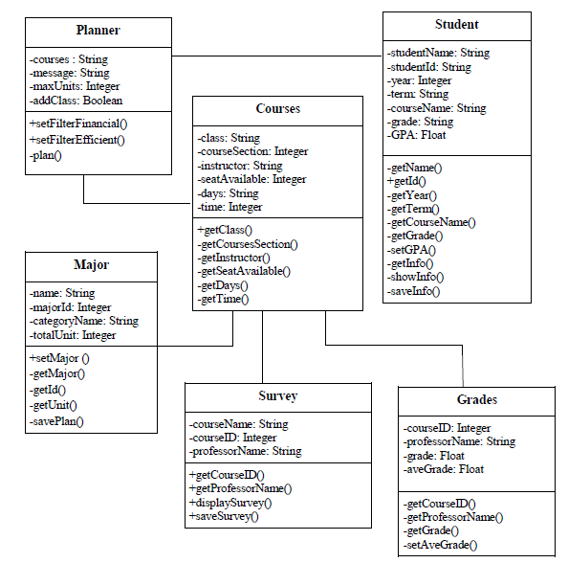
Architectural and component-level design

Slide 5
Component Interface Descriptions

Slide 6
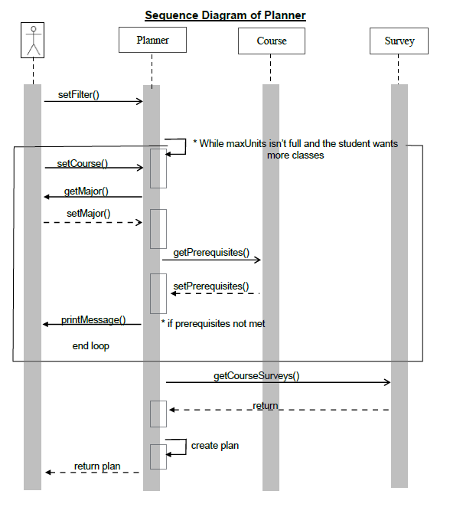
Planner
Planner component is responsible for creating a plan to earn a degree for specified program or major. The user’s filter is applied and a loop is started, while the student isn’t at max units and still wants to add more classes it will continue. Within the loop the user selects a course. The component gets the major from the user and retrieves prerequisites for the course, a message is printed if prerequisites are not met. After the loop ends the component retrieves the survey information and creates an optimized plan for the user.

Slide 7
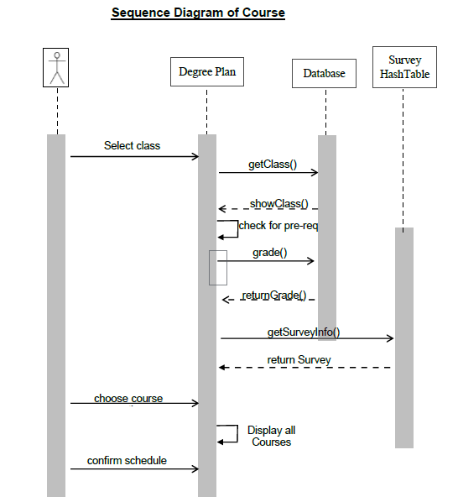
Course
Course component is responsible for returning a list of available classes for a semester based on the major chosen. The course component also interacts with the survey and grades component to compile extra data for the user such as average grades, professor ratings, estimated workloads.

Slide 8
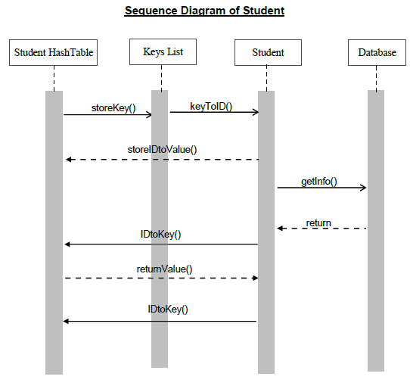
Student
Student component responsibilities is to allocate student objects to a hash table. The student object itself holds information from the database. The student object is assigned a key value for the student hash table. The student object retrieves information from the database to be stored in the object on the hash table. The information is stored from the student ID number as the key to access the location in the hash table.

Slide 9
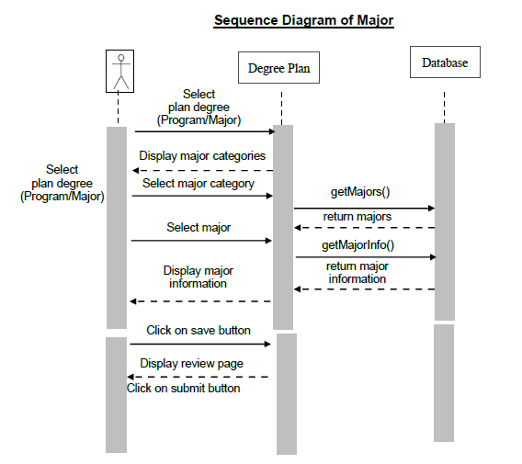
Major
The Major component is responsible for selecting the major for the user and storing it within the database. The major component waits for input after displaying the major categories. When the user selects a major category it retrieves the major from the database along with the information of the selected major. Once the user chooses to save the component will display a review page and wait for user to select submit to save the selected major to the database. After the major the user selected is saved to the database a confirmation message is displayed.

Slide 10
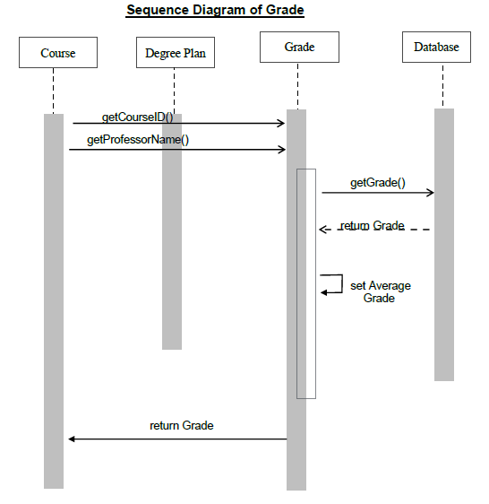
Grade
Grade component is responsible for getting grades at the end of a semester and stores in the course component. The component will get the course ID and professor’s name. After the component will get grades from the Database based on the course ID and professor’s name. The GPA will be calculated and the component will return to the course.

Slide 11
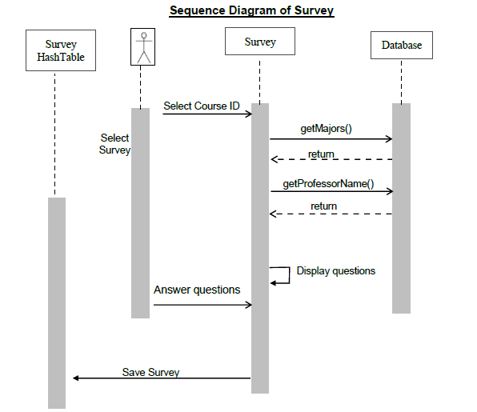
Survey
Survey component is responsible for collecting data for a class from students to present to future students who may take the class later. The user is prompted to take the survey for their course. The survey pulls information on the student’s major and their Professor’s name. The survey displays the questions and the user answers the questions which then get saved into a hash table where the results are stored.

Slide 12
User Interface Design & Rules

Slide 13
User Interface Design rules
The following rules for Degree Planner was drafted from Shneiderman’s “Eight Golden Rules of Interface Design”.
1. Offer informative feedback.
2.Design dialog to yield closure.
3. Permit easy reversal of actions.
4. Offer simple error handling
5. Support internal locus of control.
6. Strive for consistency. 7. Reduce short-term memory load

Slide 14
Demo & Test Plan

Slide 15
Thank for your Time

